Slide 1
Personal Portfolio
Case Study
22bca271:
Nitya PiyushKumar Sakalsawala

Slide 2
Web-Pages
There are 6 webpages :-
1. Home page : Where there is information about me.
2. My Work : What type of work I have done and what is my future goal.
3. My Blog : What are my Research.
4. My Qualification : What are my actual Qualification.
5. Contact Page : It is one and only dynamic web page where user can give there information and can contact with me in Instagram , twitter & Whatsapp.
6. Conformation page : When the person submit the form with a validation then in backend information can be store and conformation page pop out.

Slide 3
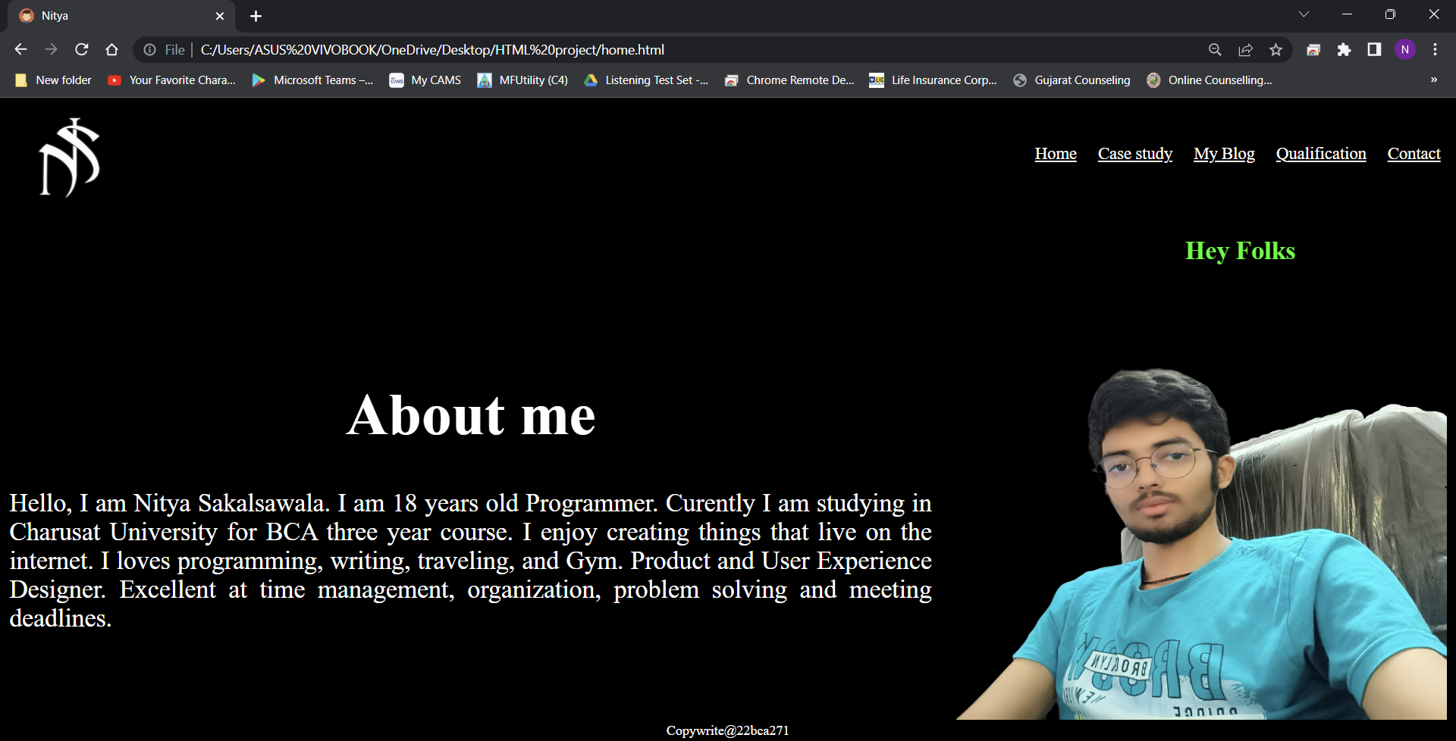

Slide 4
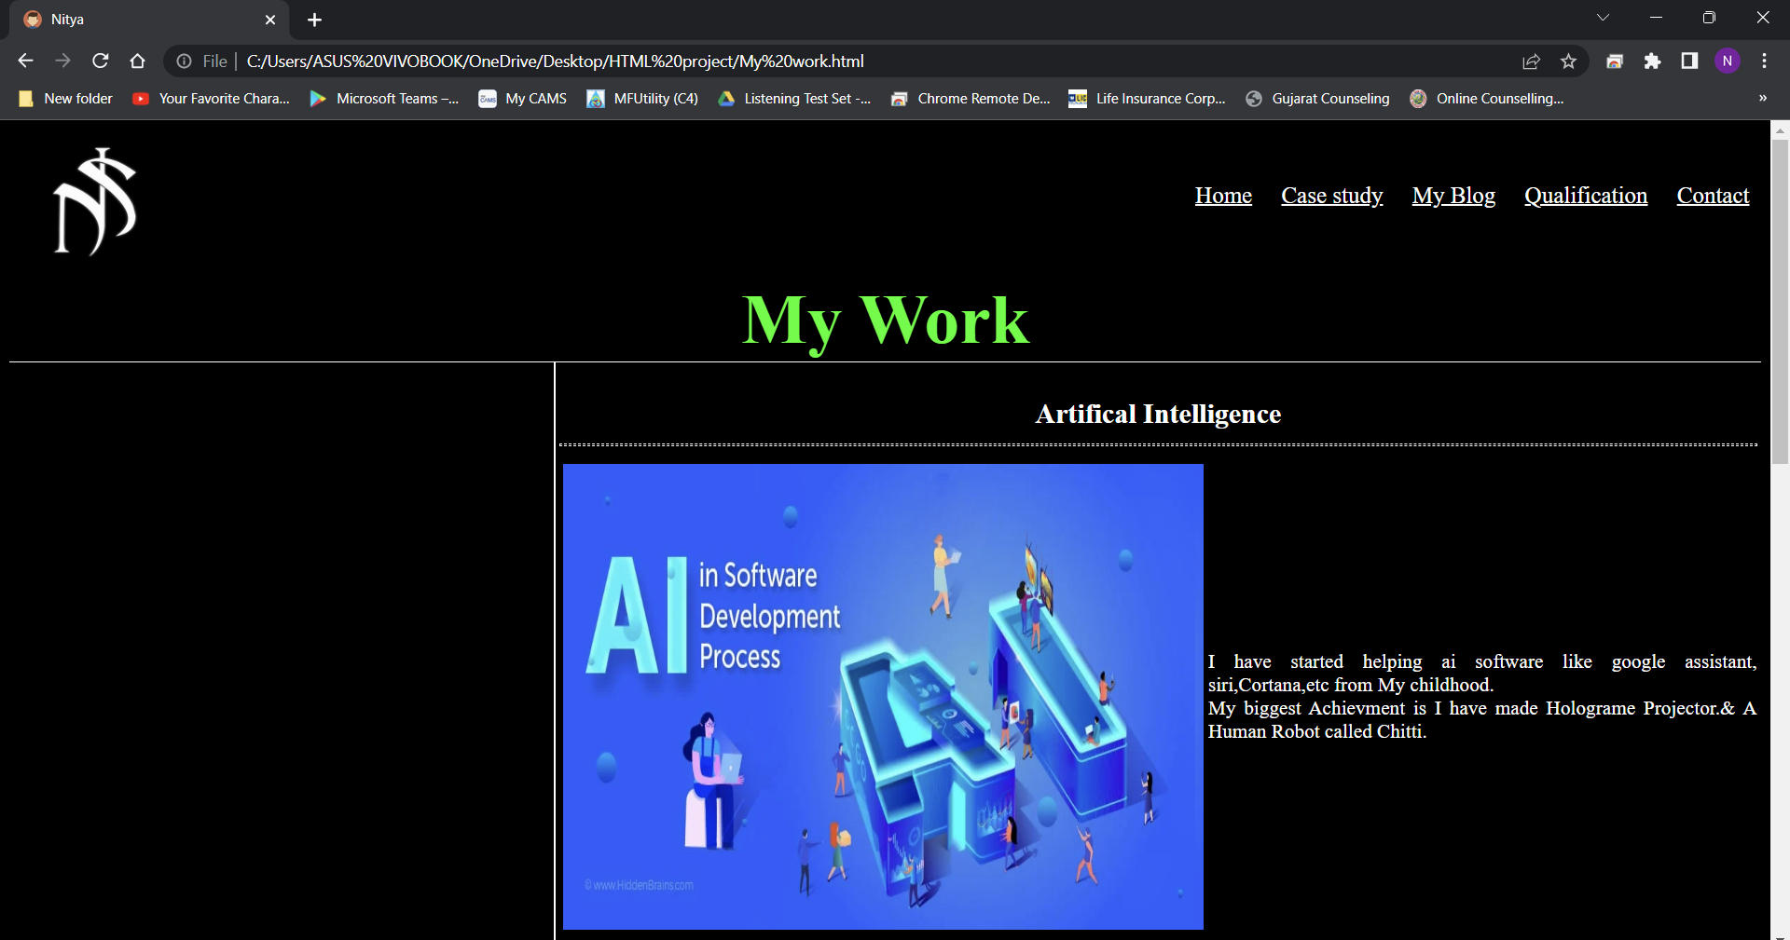
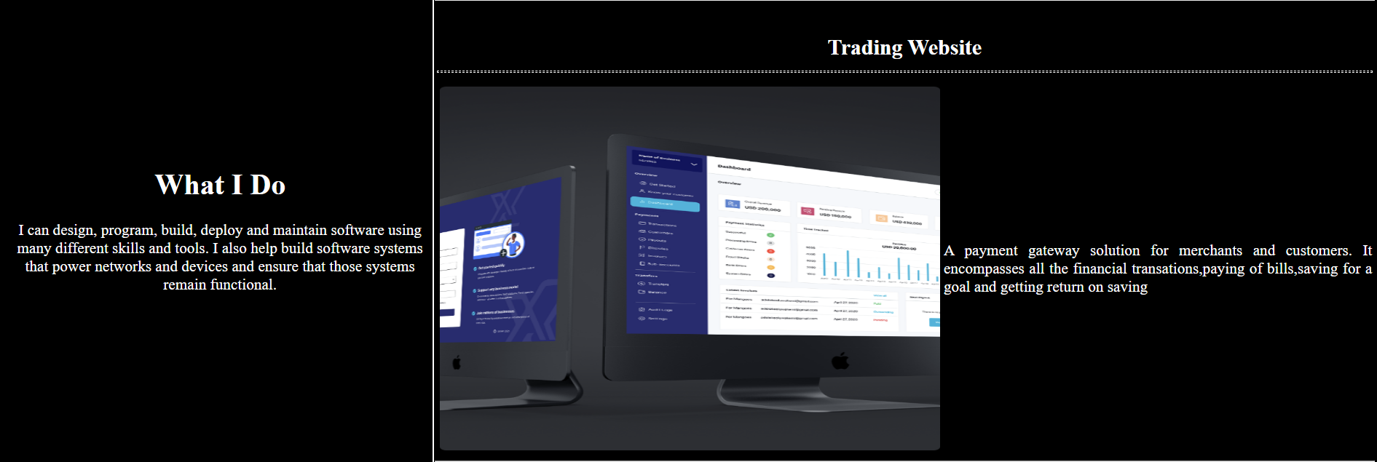
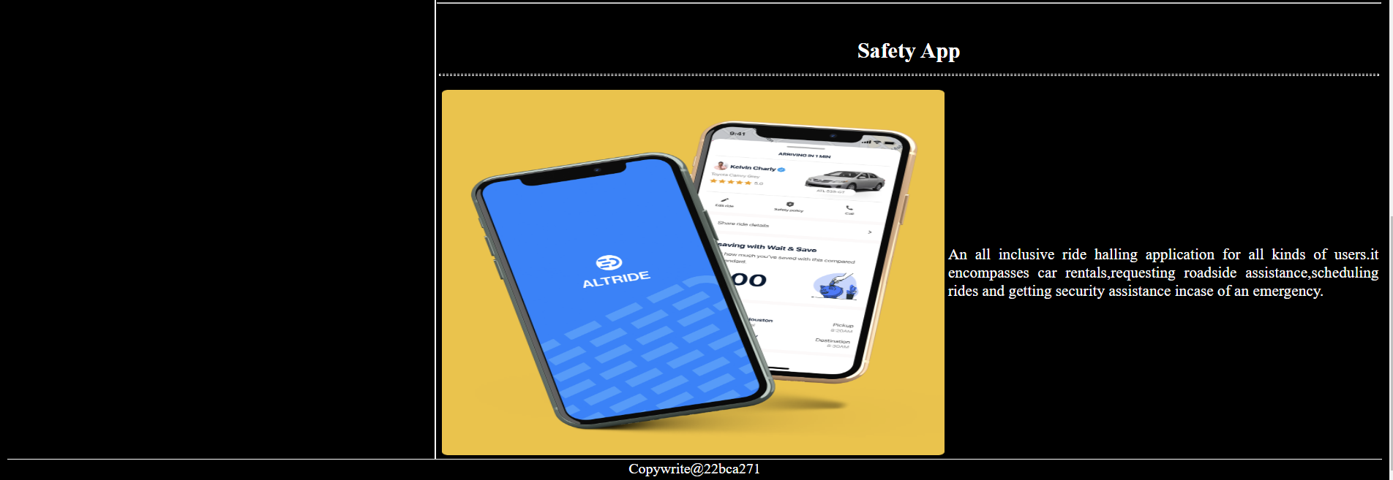

Slide 5
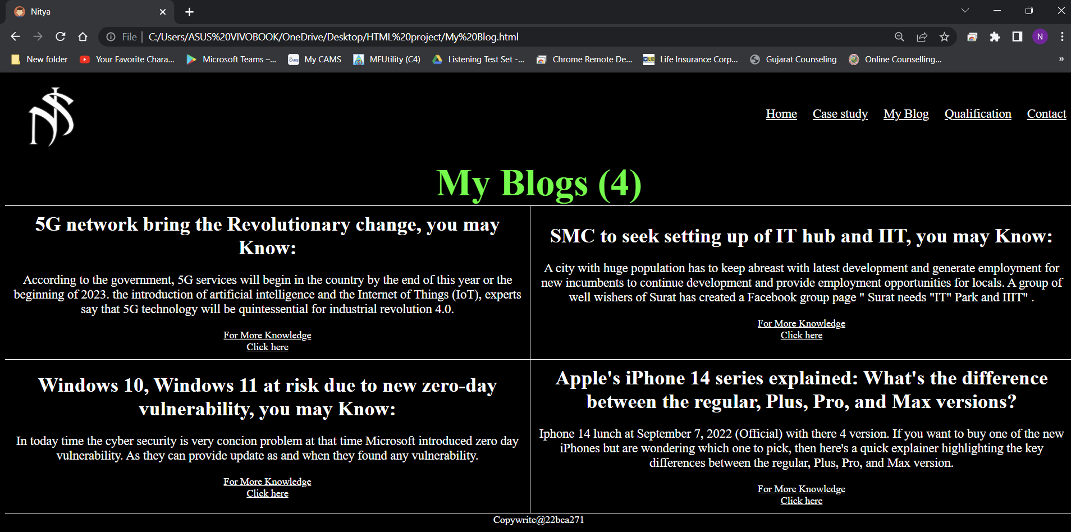

Slide 6
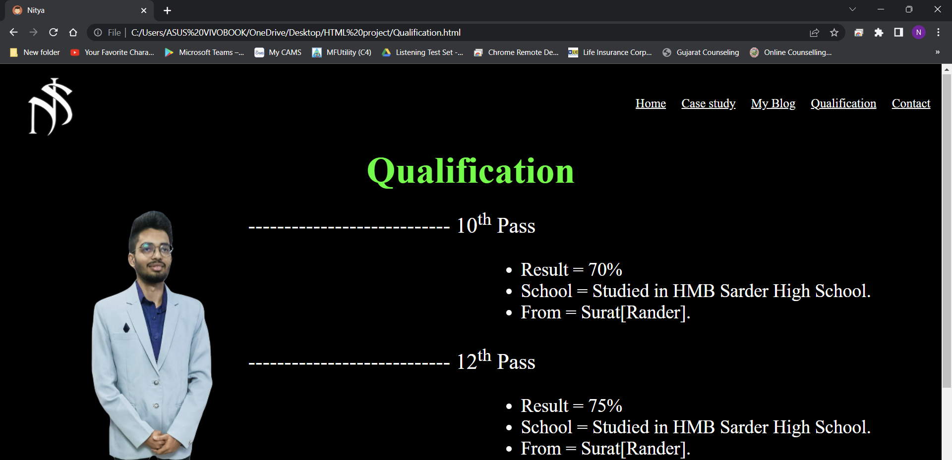
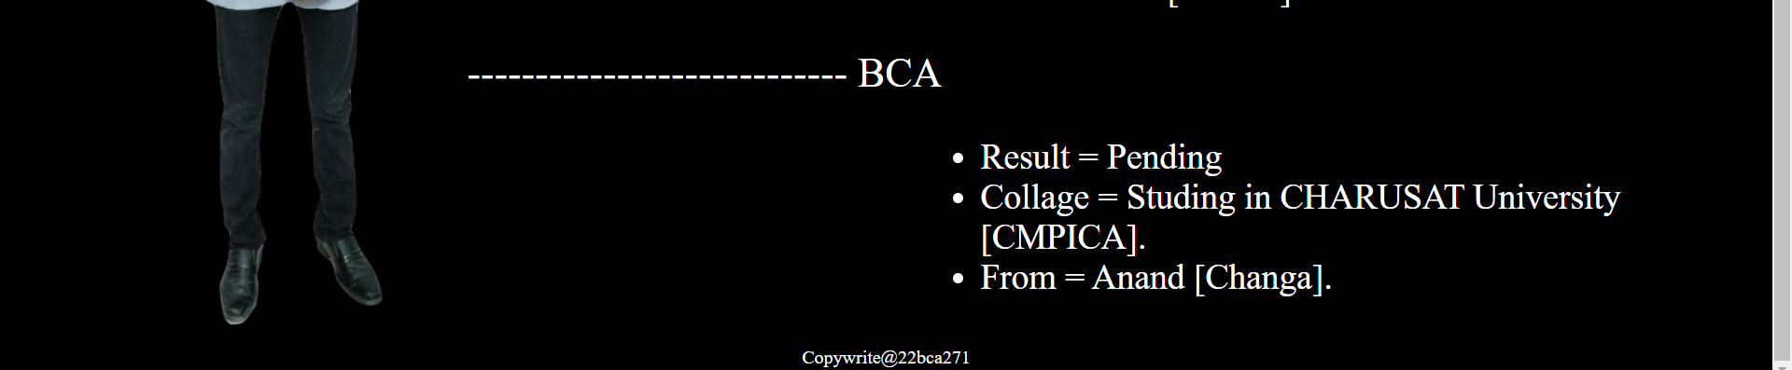

Slide 7
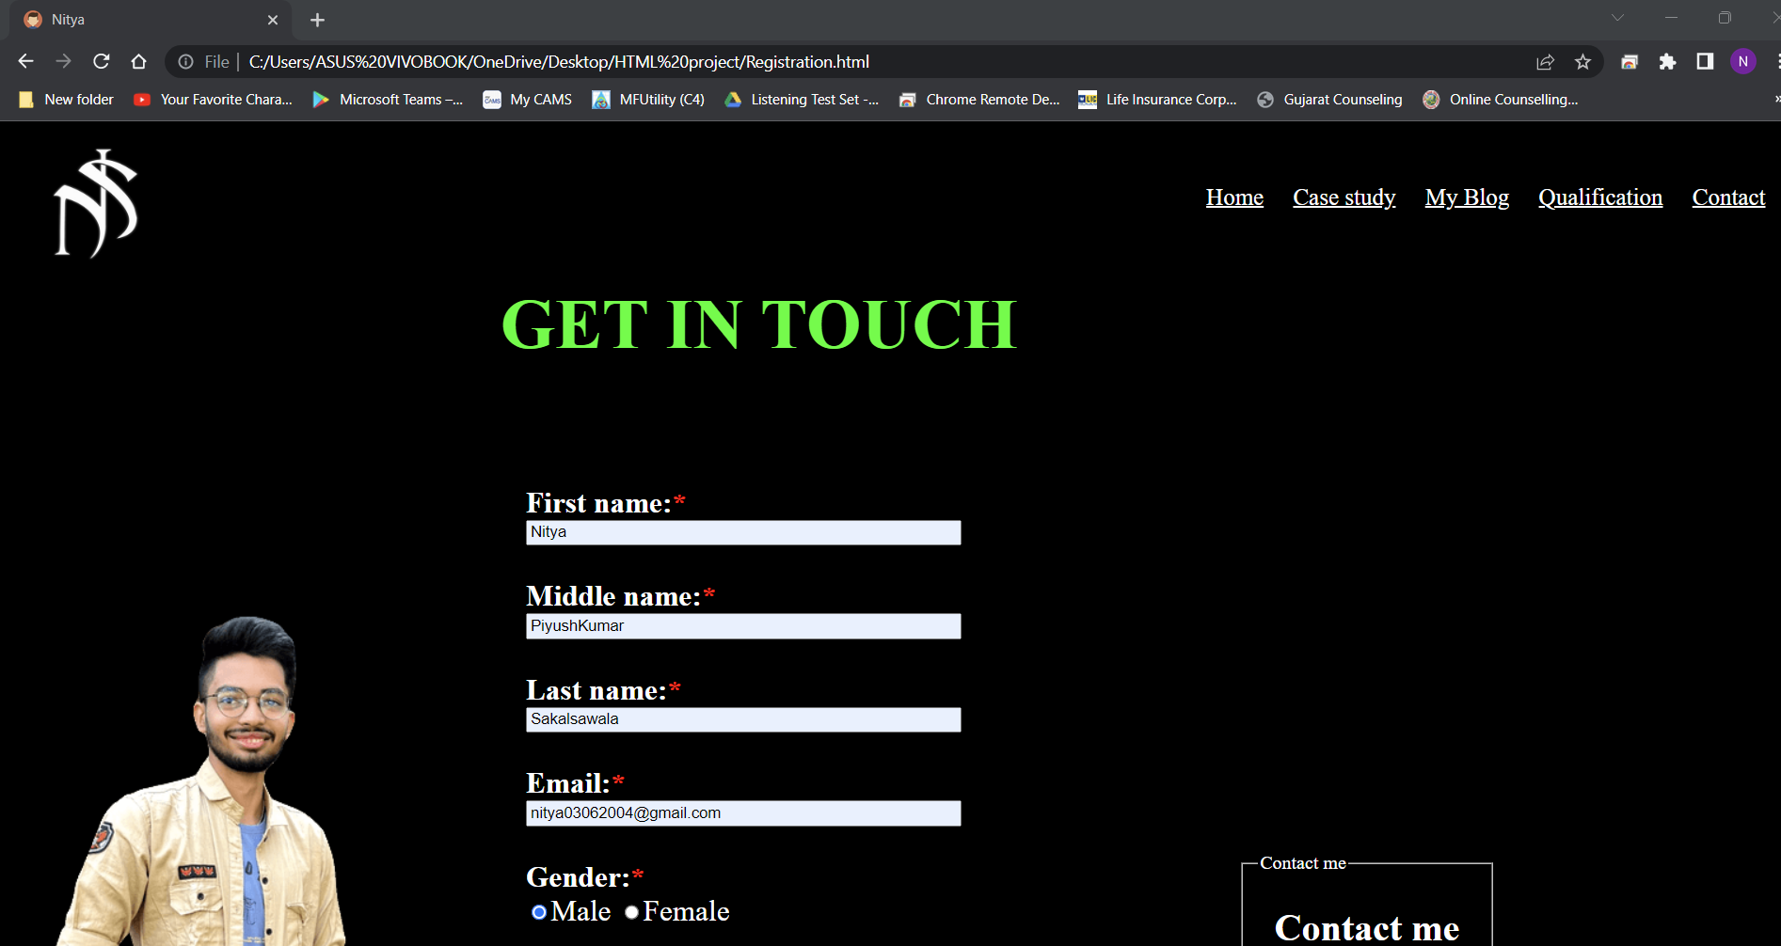
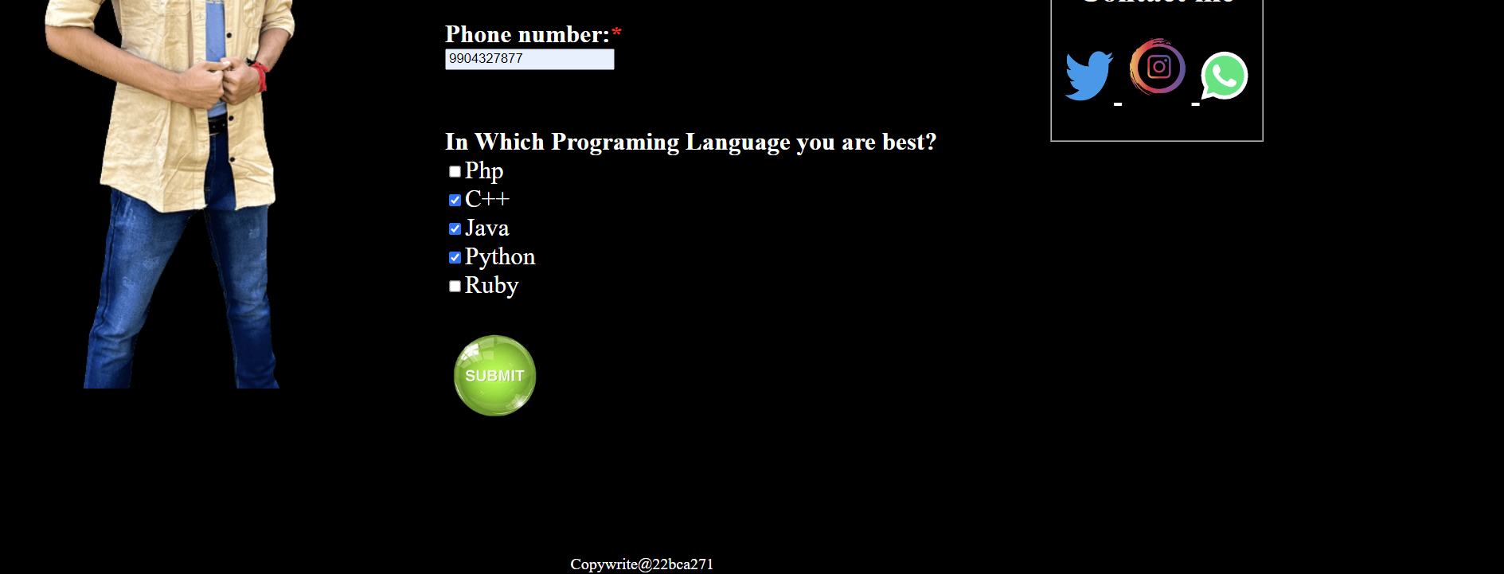

Slide 8
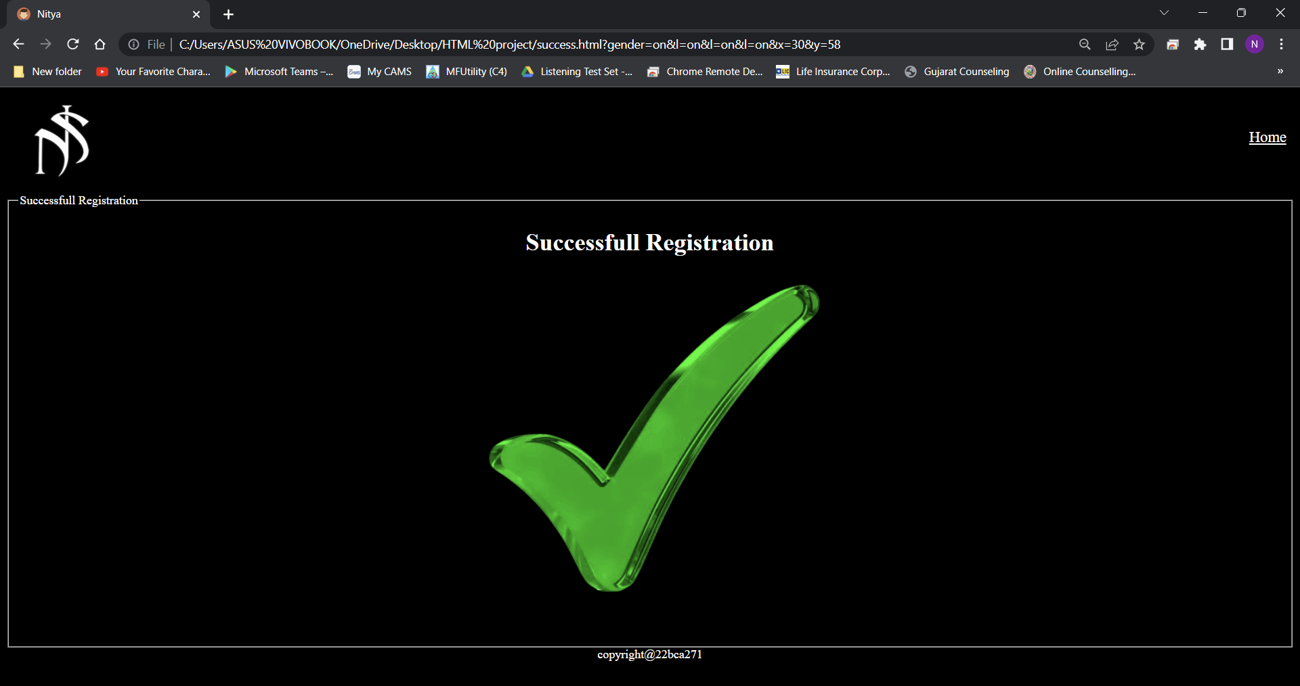

Slide 9
Benefit
An Online Portfolio Provides a Platform to Highlight Your Best Work
A Digital Portfolio Reflects Your Personality and Creativity
An Online Portfolio is a Business Card for Future Clients and Potential Employers
Online Portfolios Establish and Strengthen Your Brand
When I want knowledge of any programing language then I can contact to that person

